Slide 1
N P Complete Languages
V.Vijayarajan
Assistant Professor
SCSE, VIT University
Vellore

Slide 2
NP-complete Languages

Slide 3




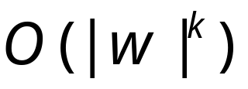
Polynomial Time Reductions
Polynomial Computable function :
There is a deterministic Turing machine
such that for any string computes
in polynomial time:

Slide 4
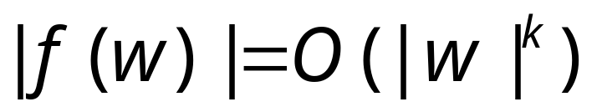
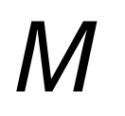
Observation:
since, cannot use
more than tape space
in time

Slide 5


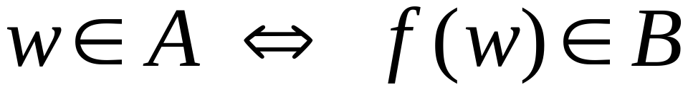
Definition:
Language
is polynomial time reducible to
language
if there is a polynomial computable
function such that:

Slide 6





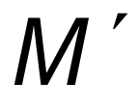
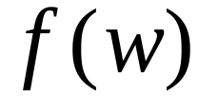
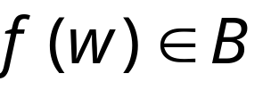

Theorem:
Suppose that is polynomial reducible to .
If then .
Proof:
Let be the machine that decides
in polynomial time
Machine to decide in polynomial time:
On input string :
1. Compute
2. Run on input
3. If acccept

Slide 7
Example of a polynomial-time reduction:
We will reduce the
3CNF-satisfiability problem
to the
CLIQUE problem

Slide 8
3CNF formula:
literal
clause
Each clause has three literals
Language:
3CNF-SAT ={ : is a satisfiable
3CNF formula}

Slide 9



A 5-clique in graph
Language:
CLIQUE = { : graph
contains a -clique}

Slide 10
Theorem:
3CNF-SAT is polynomial time
reducible to CLIQUE
Proof:
give a polynomial time reduction
of one problem to the other
Transform formula to graph

Slide 11










Transform formula to graph.
Example:
Clause 2
Create Nodes:
Clause 3
Clause 1
Clause 4

Slide 12


Add link from a literal to a literal in every
other clause, except the complement

Slide 13
Resulting Graph

Slide 14
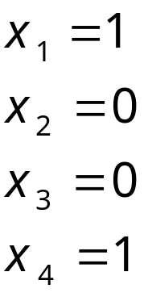
The formula is satisfied if and only if
the Graph has a 4-clique
End of Proof

Slide 15
NP-complete Languages
We define the class of NP-complete
languages
Decidable
NP
NP-complete

Slide 16

A language is NP-complete if:
is in NP, and
Every language in NP
is reduced to
in polynomial time

Slide 17

Observation:
If a NP-complete language
is proven to be in P then:

Slide 18
Decidable
NP
P
NP-complete
?

Slide 19
An NP-complete Language
Cook-Levin Theorem:
Language SAT (satisfiability problem)
is NP-complete
Proof:
Part1:
SAT is in NP
(we have proven this in previous class)
Part2: reduce all NP languages
to the SAT problem
in polynomial time

Slide 20
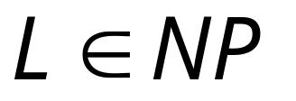

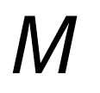
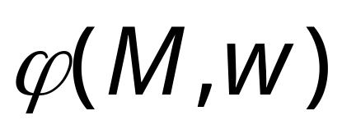
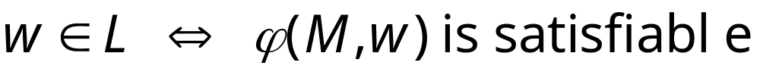
Take an arbitrary language
We will give a polynomial reduction of to SAT
Let be the NonDeterministic
Turing Machine that decides in polyn. time
For any string we will construct
in polynomial time a Boolean expression
such that:

Slide 21

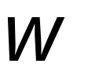


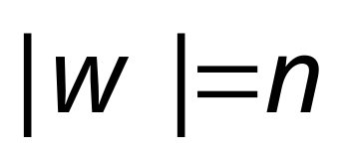
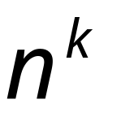
All computations
of on string
depth
…
…
…
…
accept
reject
accept
(deepest leaf)
reject

Slide 22
Consider
an accepting
computation
depth
…
…
…
…
accept
reject
accept
(deepest leaf)
reject

Slide 23

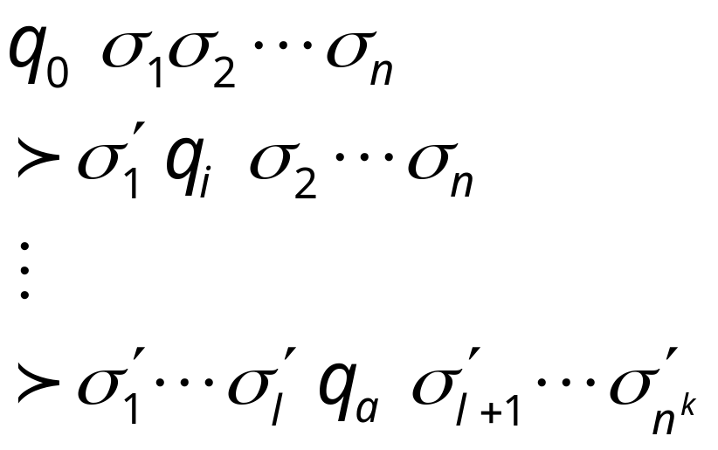



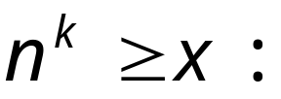

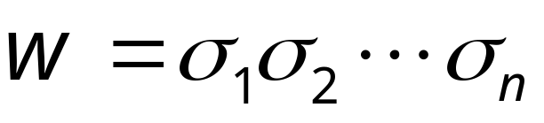
Computation path
Sequence of
Configurations
initial state
…
accept state
accept

Slide 24


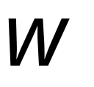

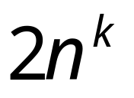
Machine Tape
Maximum working space area on tape
during time steps

Slide 25
















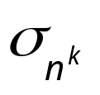


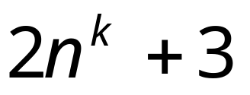
Tableau of Configurations
……
Accept configuration
indentical rows

Slide 26
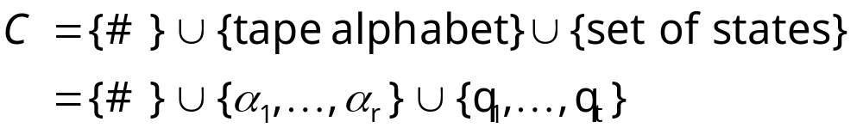
Tableau Alphabet
Finite size (constant)

Slide 27
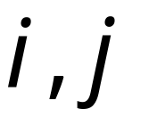
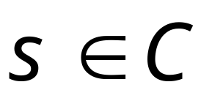
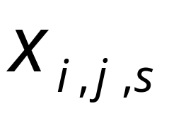

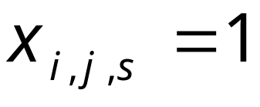
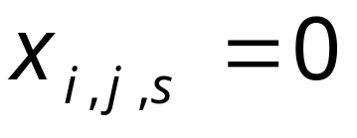
For every cell position
and
for every symbol in tableau alphabet
Define variable
Such that if cell contains symbol
Then
Else

Slide 28

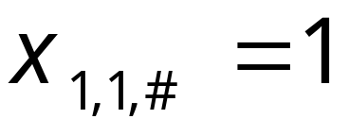
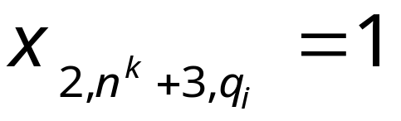
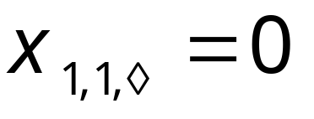
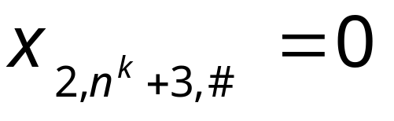
Examples:

Slide 29


is built from variables
When the formula is satisfied,
it describes an accepting computation
in the tableau
of machine on input

Slide 30
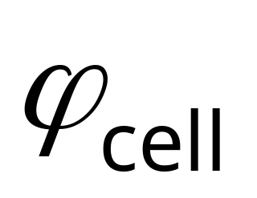
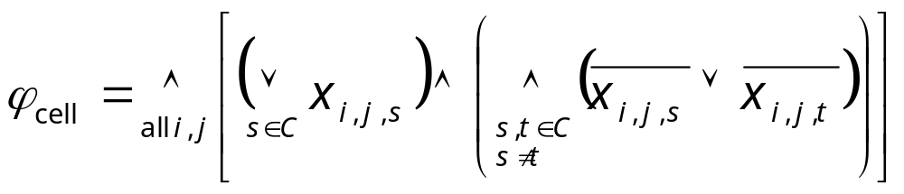
makes sure that every
cell in the tableau contains
exactly one symbol
Every cell contains
at least one symbol
Every cell contains
at most one symbol

Slide 31
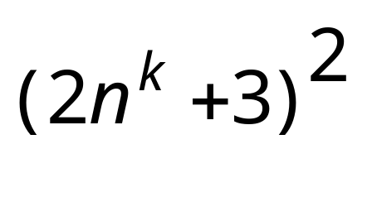



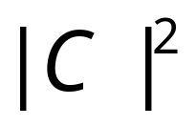


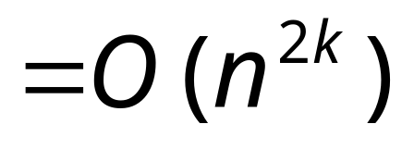
Size of :

Slide 32
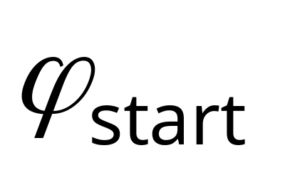
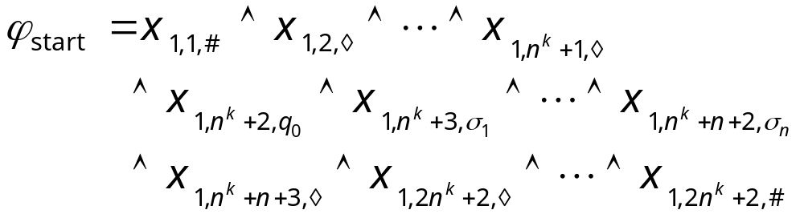
makes sure that the tableau
starts with the initial configuration
Describes the initial configuration
in row 1 of tableau

Slide 33
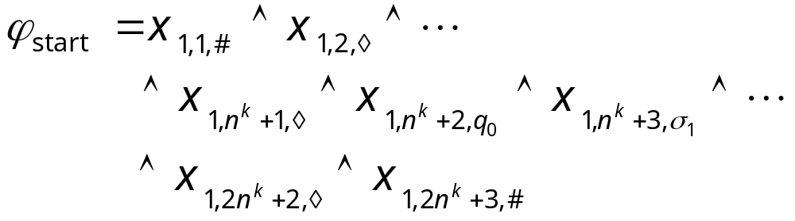
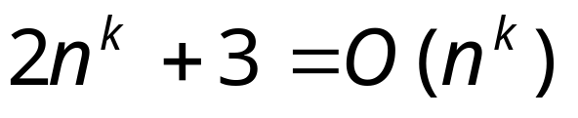
Size of :

Slide 34
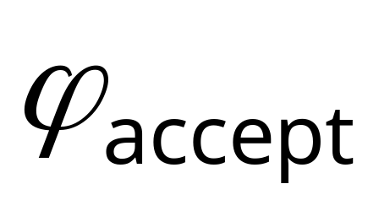
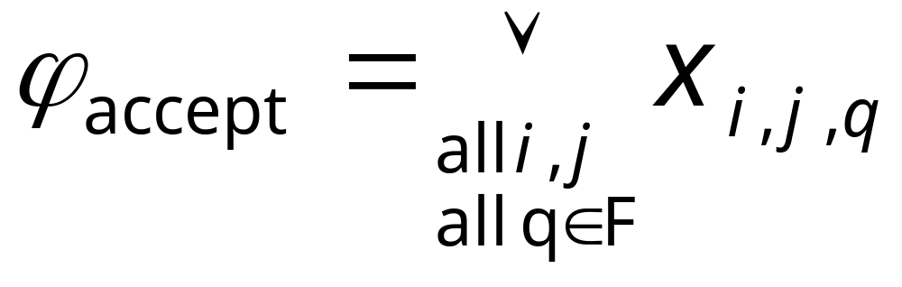
makes sure that the computation
leads to acceptance
Accepting states
An accept state should appear somewhere
in the tableau

Slide 35
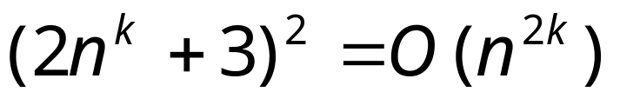
Size of :

Slide 36

makes sure that the tableau
gives a valid sequence
of configurations
is expressed in terms of
legal windows

Slide 37





Tableau
Window
2x6 area of cells

Slide 38



Possible Legal windows
Legal windows obey the transitions

Slide 39
Possible illegal windows

Slide 40
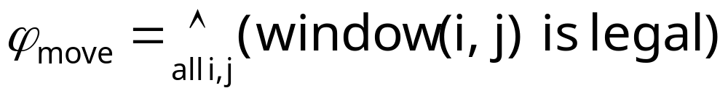



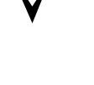
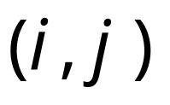
window (i,j) is legal:
((is legal)
(is legal)
(is legal))
all possible legal windows
in position

Slide 41
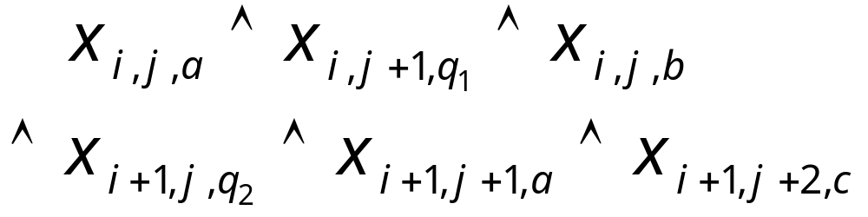
(is legal)
Formula:

Slide 42


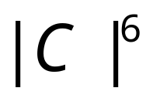
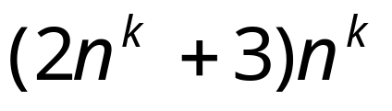


Size of :
Size of formula for a legal window
in a cell i,j:
Number of possible legal windows
in a cell i,j:
at most
Number of possible cells:

Slide 43




Size of :
it can also be constructed in time
polynomial in

Slide 44
we have that:

Slide 45

Since,
and
is constructed
in polynomial time
is polynomial-time reducible to SAT
END OF PROOF

Slide 46
Observation 1:
The formula can be converted
to CNF (conjunctive normal form) formula
in polynomial time
Already CNF
NOT CNF
But can be converted to CNF
using distributive laws

Slide 47


Distributive Laws:

Slide 48

Observation 2:
The formula can also
be converted to a 3CNF formula
in polynomial time
convert

Slide 49
From Observations 1 and 2:
CNF-SAT and
3CNF-SAT are
NP-complete languages
(they are known NP languages)

Slide 50



Theorem:
If: a. Language is NP-complete
b. Language is in NP
c. is polynomial time reducible to
Then: is NP-complete
Proof:
Any language in NP
is polynomial time reducible to .
Thus, is polynomial time reducible to
(sum of two polynomial reductions,
gives a polynomial reduction)

Slide 51
Corollary:
CLIQUE is NP-complete
Proof:
a. 3CNF-SAT is NP-complete
b. CLIQUE is in NP
(shown in last class)
c. 3CNF-SAT is polynomial reducible to CLIQUE
(shown earlier)
Apply previous theorem with
A=3CNF-SAT and B=CLIQUE

